Slide 1
Raman Spectroscopy Data Exploration & Modeling Strategy for Cysteine Prediction in Pea Cultivars
Date: June 10, 2026
Presented by Priyanshu Mittal

Slide 2
Dataset Overview
20 pea cultivars, 324 spectra each = 6480 total
Each Spectrum: 1530 data points
Raman Shift range: 97.8 – 3361.7 cm^-1
Labels: Cysteine concentration (g/100g) per cultivator
Data collected across 3 field locations: Limerick, Rosthern, Sutherland
One file per spectrum, semicolon-delimited text format
Usable data starts at pixel 518

Slide 3
Dataset Anomalies
CDC Jasper – No spectral files found, only system metadata.
Status - Solved
CDC Inca – Initially had 432 spectra instead of 324.
Status - Solved
Redbat 88 – 323 spectra
Status – Need to go through

Slide 4
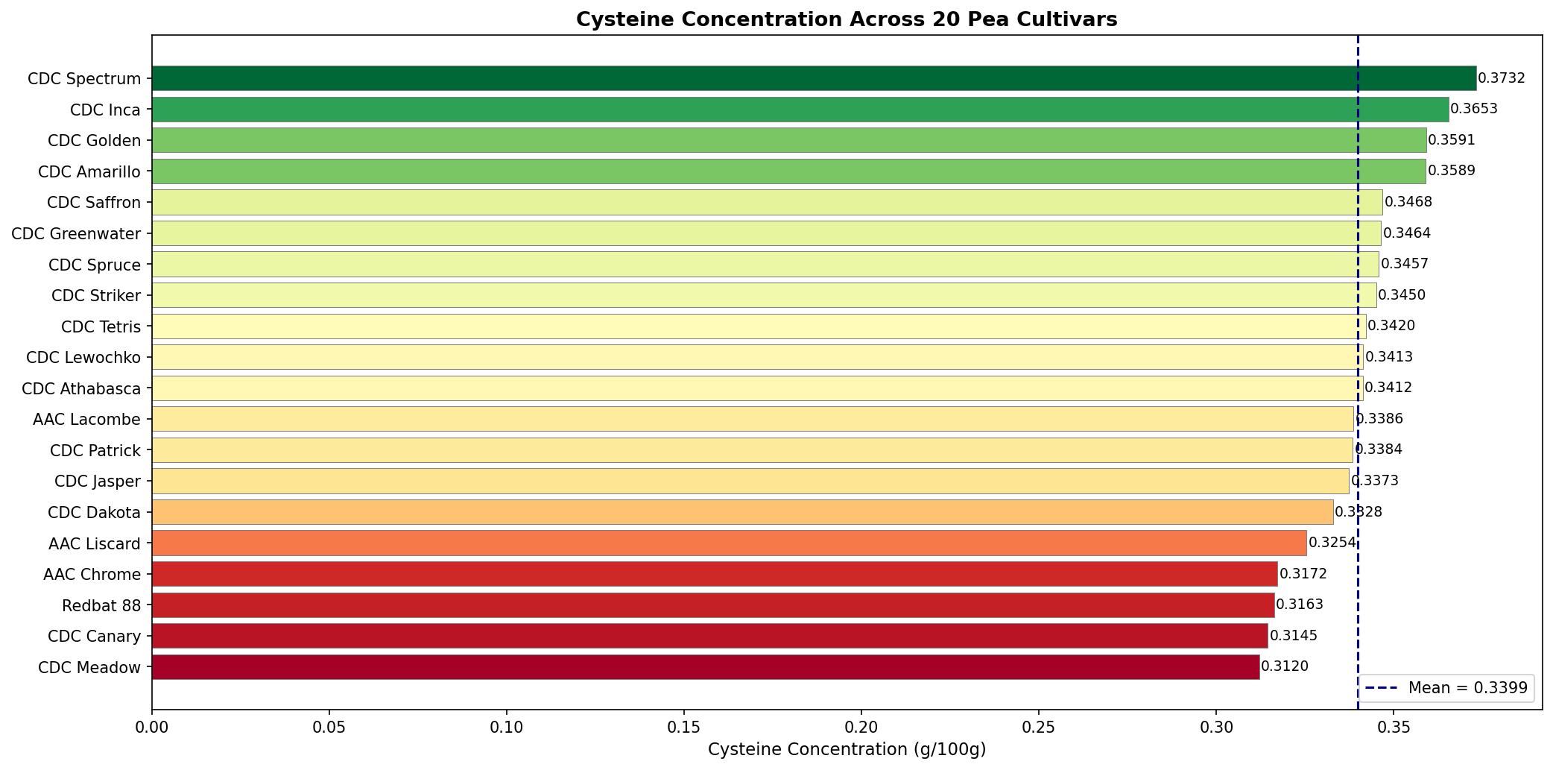
Cysteine Concentration Distribution
Notes:
Range: 0.312 – 0.373 g/100g (spread of only 0.061)
Mean: 0.34 g/100g
Highest: CDC Spectrum (0.3732)
Lowest: CDC Meadow (0.3120)
Narrow range makes this a challenging regression problem

Slide 5
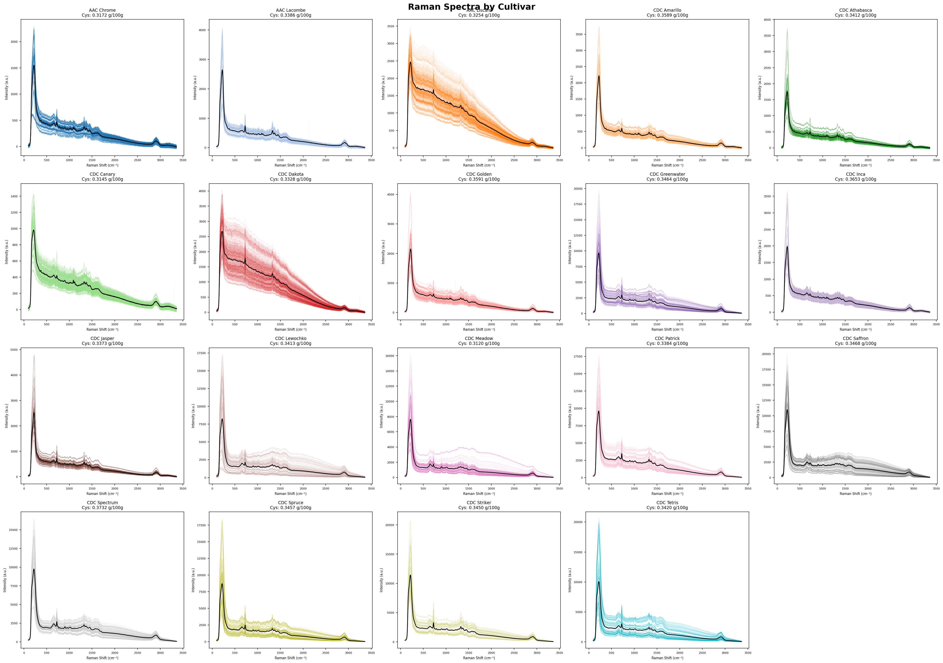
Individual Cultivar Spectra
Notes:
All cultivars share the same overall spectral shape
Dominant peak at ~200 cm⁻¹, smaller peaks at ~750 and ~1000 cm⁻¹
Within-cultivar spread varies, some cultivars (e.g. CDC Greenwater) show much higher replicate variability than others
Y-axis scales differ between cultivars → intensity normalization will be critical

Slide 6
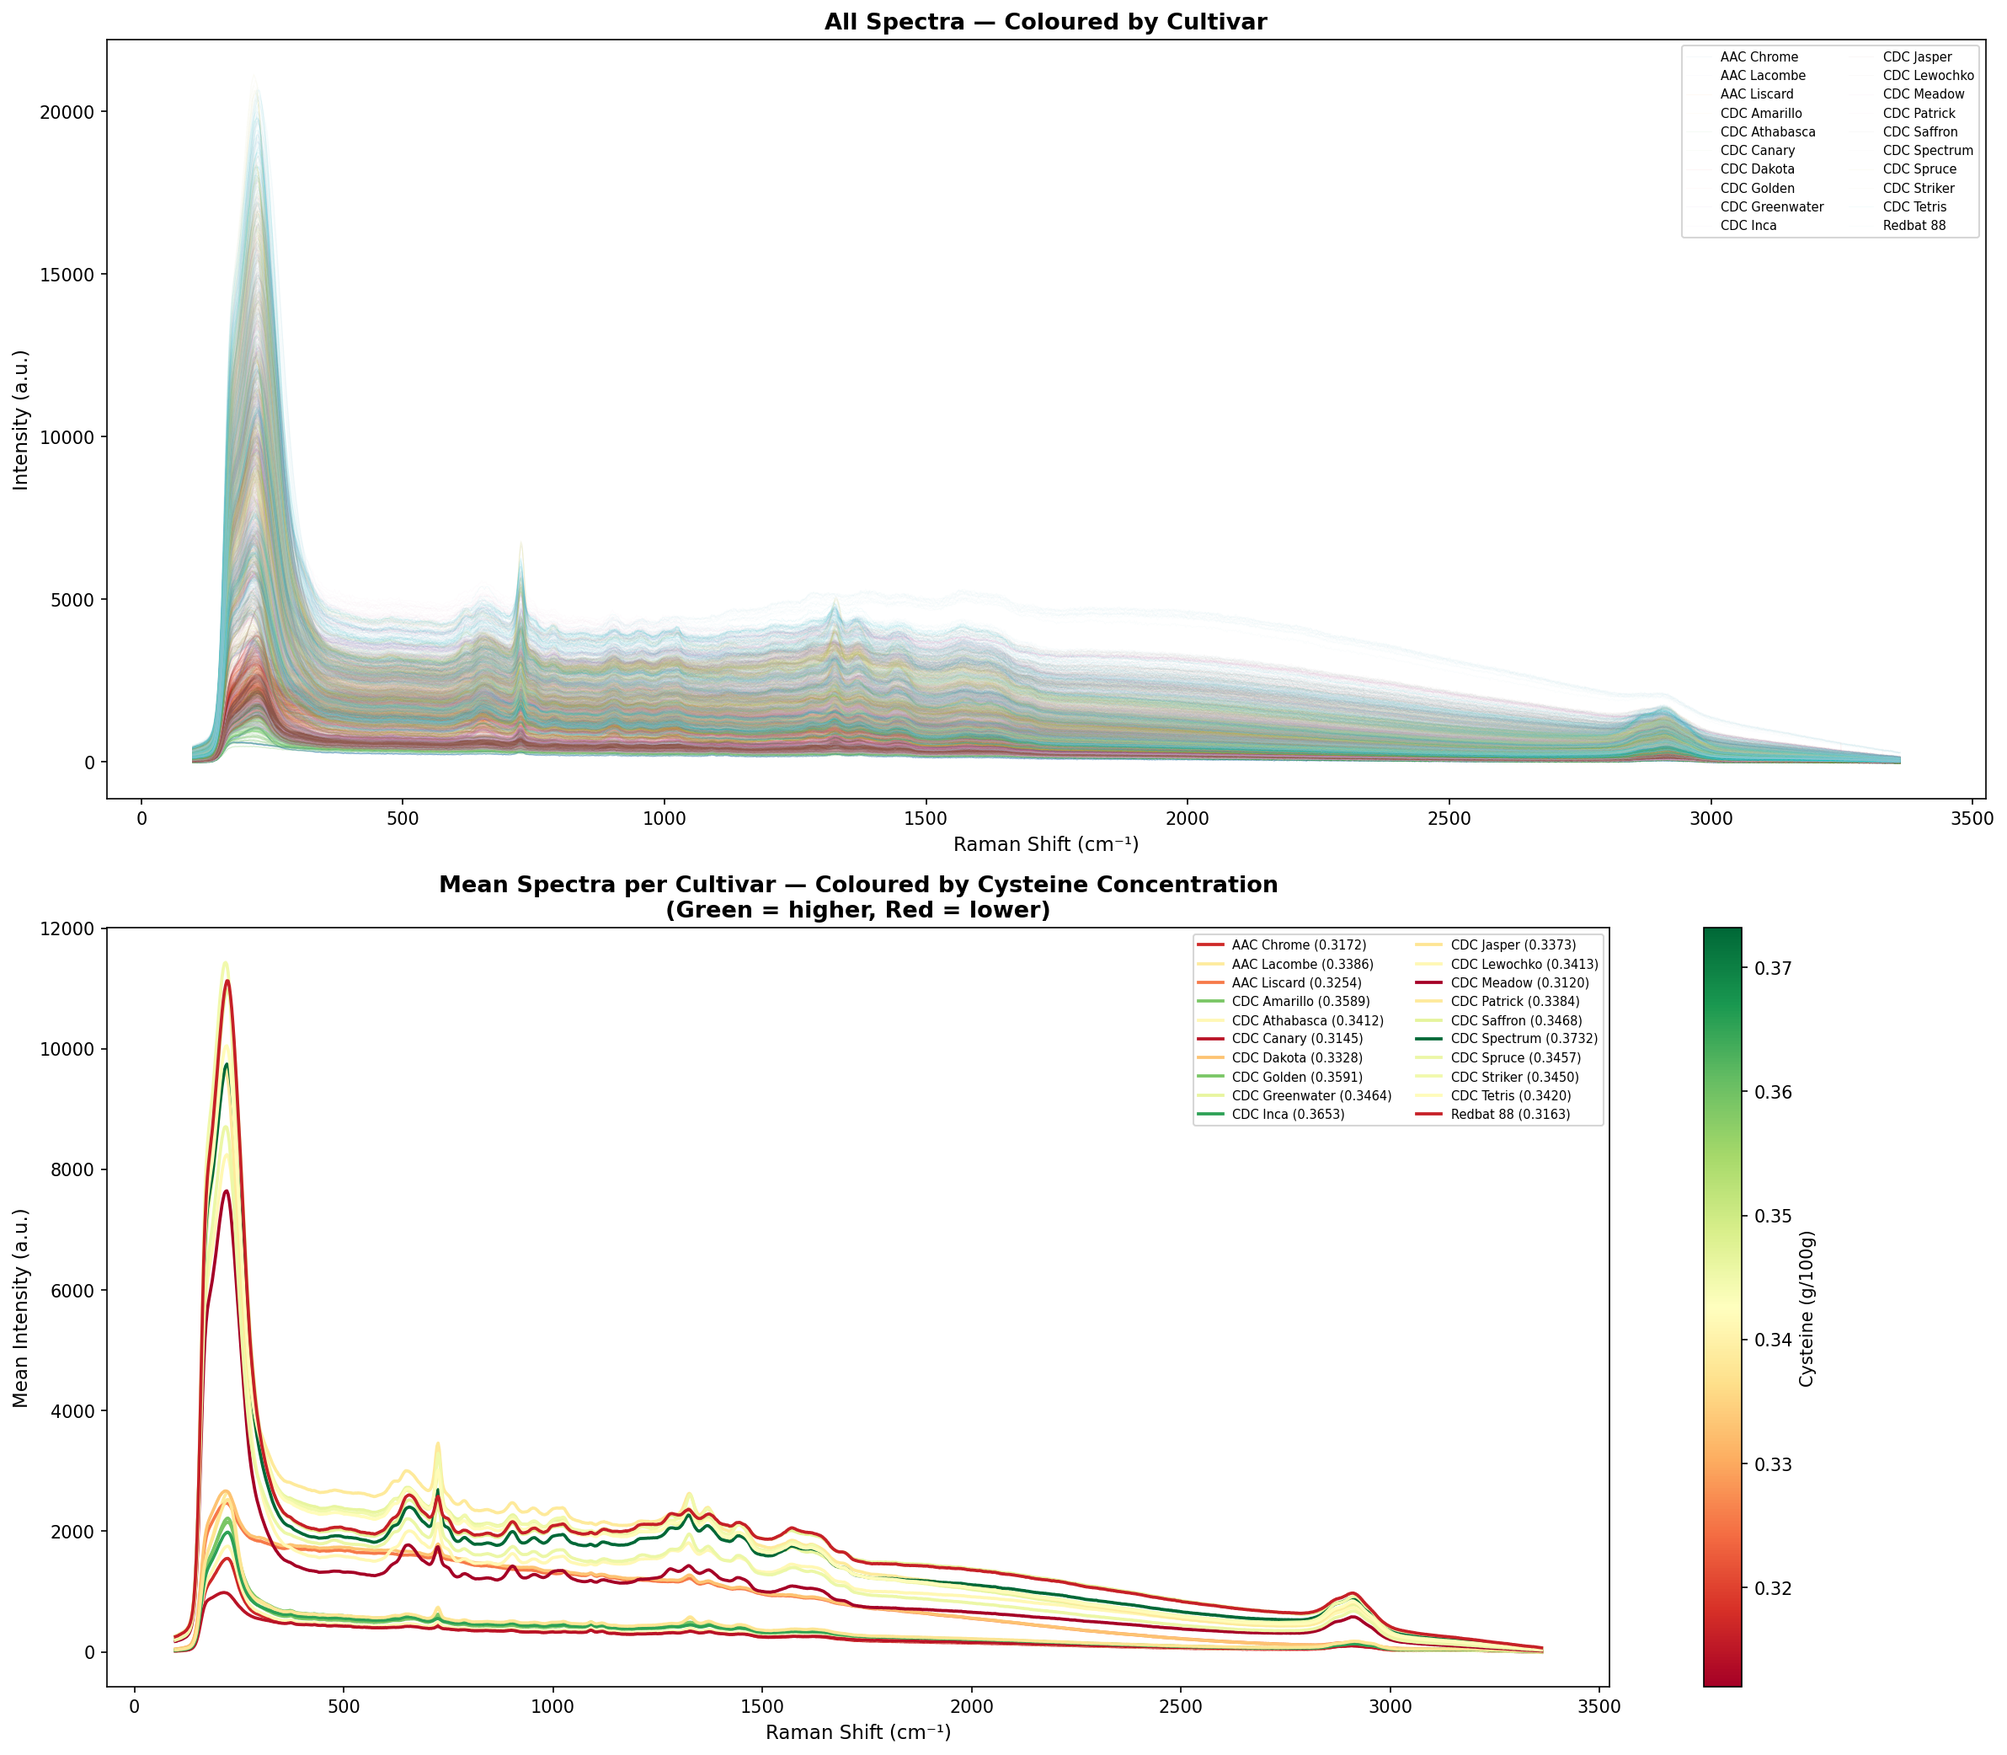
All Spectra Combined
Notes:
Top panel: large intensity scaling differences across all spectra
Bottom panel: mean spectra overlap heavily, no clear visual separation between high and low cysteine cultivars
Subtle differences exist but are not visible → machine learning needed

Slide 7
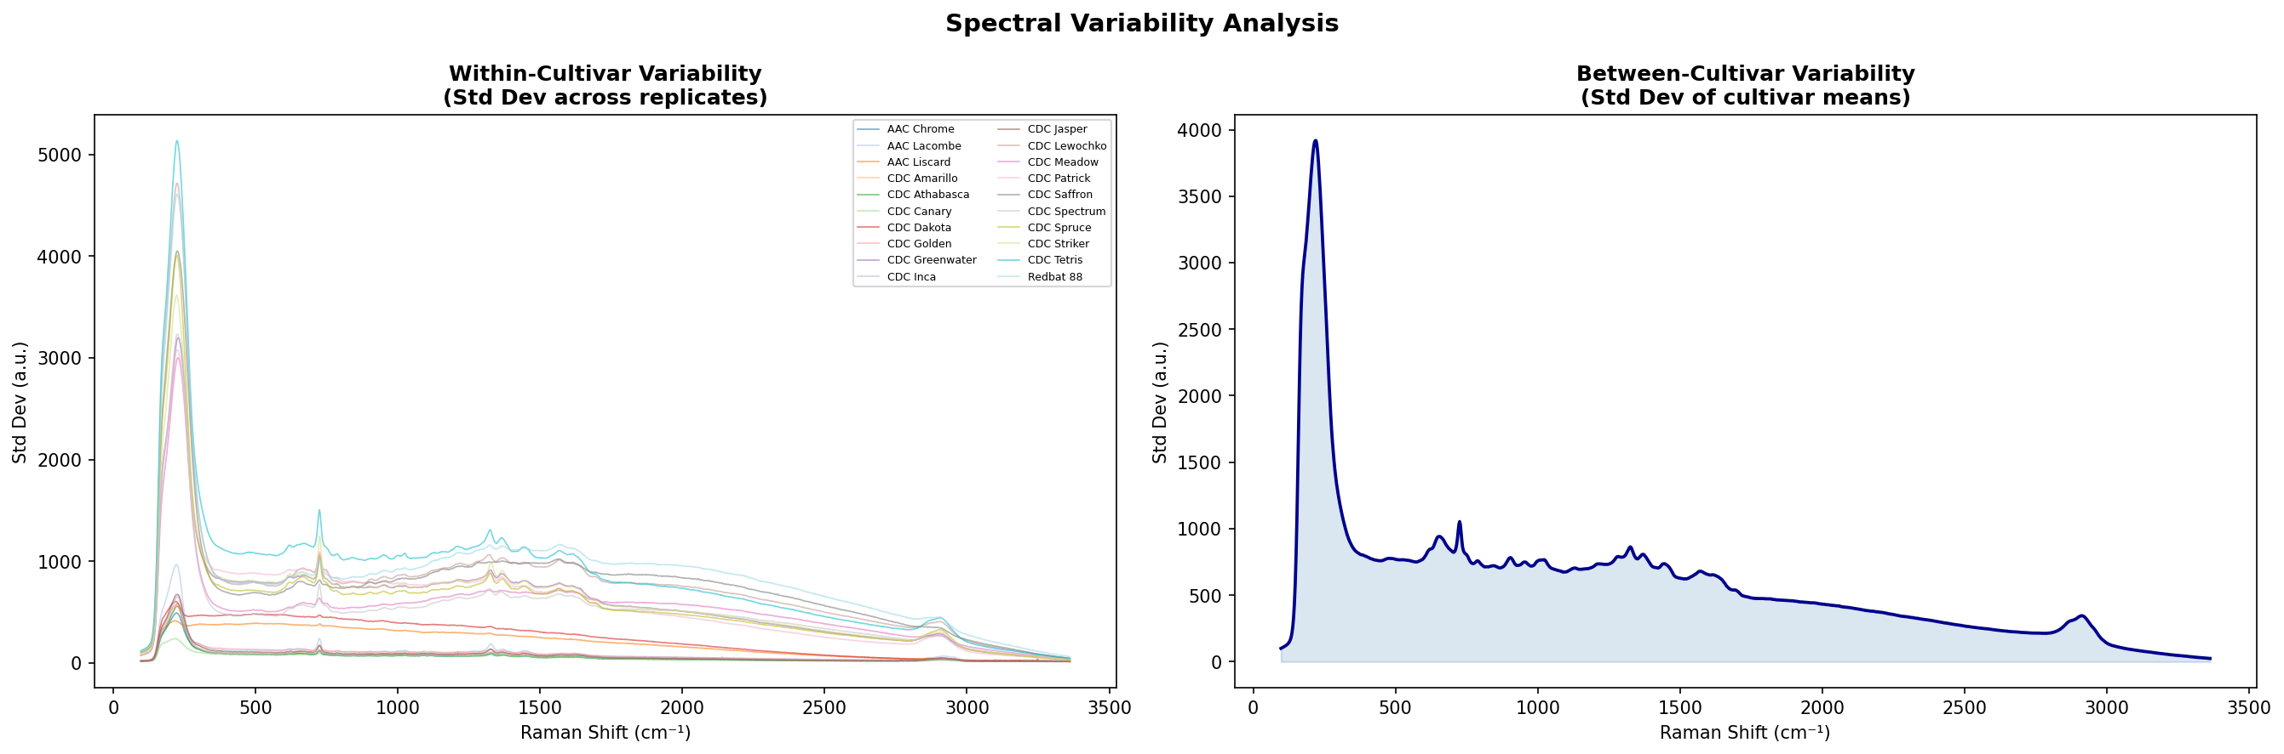
Variability Analysis
Notes:
Within-cultivar variability is highest at the main peak (~200 cm⁻¹)
Between-cultivar variability also peaks at ~200 cm⁻¹, most of the difference between cultivars is intensity scaling, not unique spectral features
Both sources of variability drop sharply after 500 cm⁻¹
Confirms that preprocessing (especially SNV normalization) is essential before modeling

Slide 8
Proposed Preprocessing
Raw Spectrum
Savitzky-Golay Smoothing
(To remove noise)
Baseline Correction (remove fluorescence)
SNV Normalisation
(fix intensity scaling)
1st and 2nd Derivative (enhance subtle oeak differences)
Why each step:
SG Smoothing: reduces noise without distorting peaks
Baseline Correction: removes broad fluorescence background
SNV: fixes the large intensity differences seen in plots
Derivative: enhances subtle differences between cultivars

Slide 9
Proposed Models
Partial Least Square Regression (PLSR) | Standard for spectroscopy, works well with small datasets
Support Vector Regression (SVR) | Robust to overfitting, handles high emissions
Principal Component Regression (PCR) | Simple baseline comparison to PLSR
Random Forrest | Captures non-linear relationships
1D-CNN | Learns spectral patterns automatically

Slide 10
Evaluation Strategy
Why not random split?
Spectra from the same cultivars share one label.
Random splitting would leak information and inflate performance.
Approach: Leave One Cultivar Out Cross Validation
Hold out all 324 spectra from one cultivar
Train on remaining 19 cultivars
Predict held-out cultivar
Repeat 20 times

Slide 11
Summary
Dataset fully explored: 20 cultivars, 6,480 spectra
Key challenge: narrow cysteine range (0.061 g/100g spread)
Preprocessing pipeline defined
Modeling strategy ready

